Slide 1
Movie Revenue Prediction
Internship Project by Vijay

Slide 2
Agenda
Introduction
Problem Statement
Dataset and Features
Data Preprocessing
Data Visualization
Machine Learning Model
Results and Evaluation
Flask Web App Structure
Frontend Interface
Demo / Workflow
Conclusion

Slide 3
Introduction
Predict movie revenue using machine learning.
Useful for producers, investors, and studios.
Based on features like budget, popularity, runtime, and release year.

Slide 4
Problem Statement
Manual prediction methods are unreliable.
Need a data-driven approach.
Build a machine learning model to estimate movie revenue accurately.

Slide 5
Dataset and Features
Budget: Total production cost of the movie (in USD).
Popularity: A numeric score indicating public interest.
Runtime: Duration of the movie in minutes.
Release Year: Year the movie was released.
These features are used as inputs to the machine learning model.

Slide 6
Data Preprocessing
Removed nulls and outliers
Converted release date into year, month, weekday
Scaled features using Standard Scaler
Encoded categorical variables

Slide 7
Data Visualization
Data Visualization is the graphical representation of information and data. By using visual elements like charts, graphs, and maps, data visualization tools make it easier to understand trends, outliers, and patterns in data. It is essential in data science for both exploration and communication.
Data Visualization Section:
Budget vs Revenue
Popularity vs Revenue
Release Year vs Number of Movies
Release Month vs Revenue
Revenue by Day of Week
Language Distribution
Correlation Heatmap

Slide 8
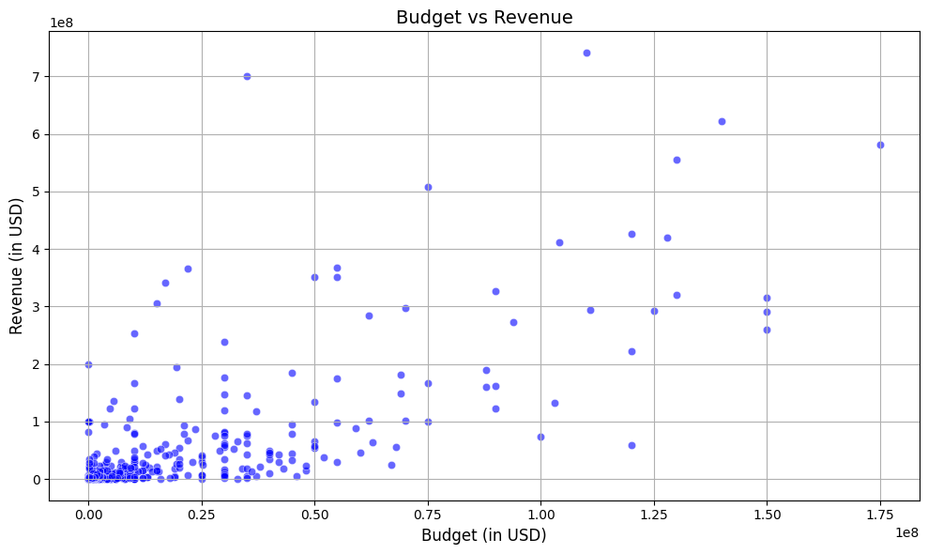
Budget vs Revenue
Type: Scatter Plot
Purpose: Shows the relationship between the movie budget and revenue.
Observation: A positive correlation—higher budgets often lead to higher revenue, but not always linearly.

Slide 9
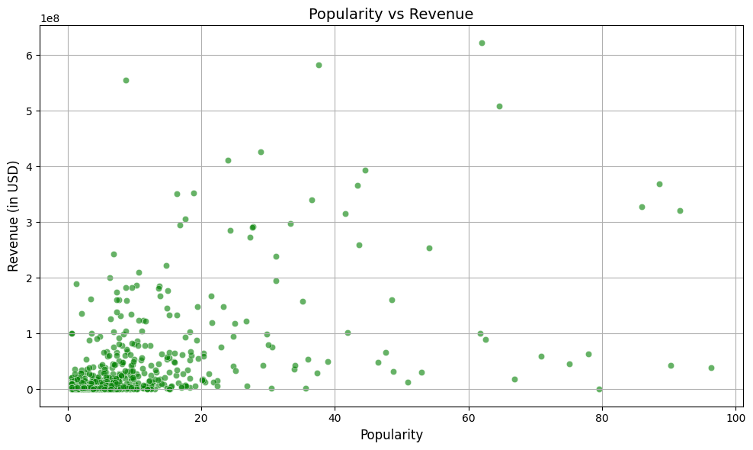
Popularity vs Revenue
Type: Scatter Plot
Purpose: Analyzes whether popular movies tend to earn more.
Observation: Moderate correlation; some low-popularity films earn well due to other factors like star cast or timing.

Slide 10
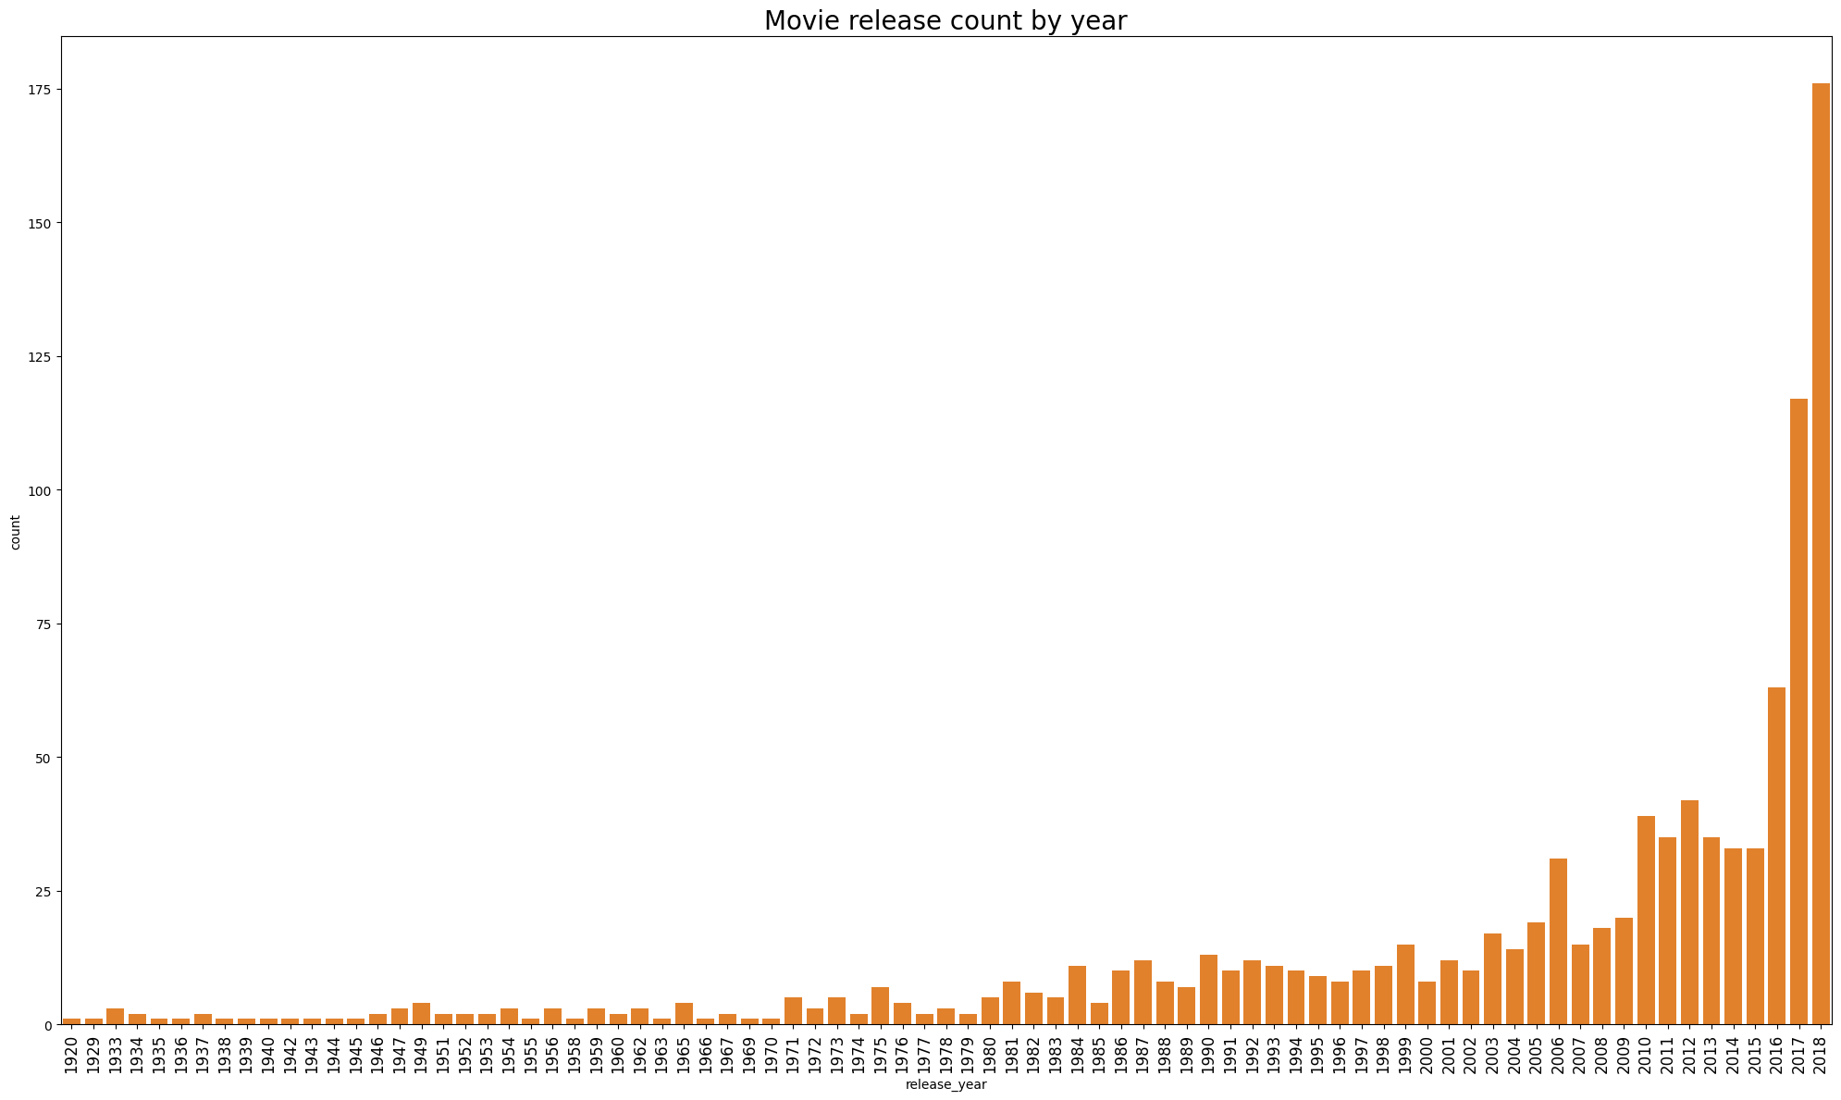
Release Year vs Number of Movies
Type: Bar Plot
Purpose: Visualizes how many movies were released each year.
Observation: Helps understand trends over time in the film industry.

Slide 11
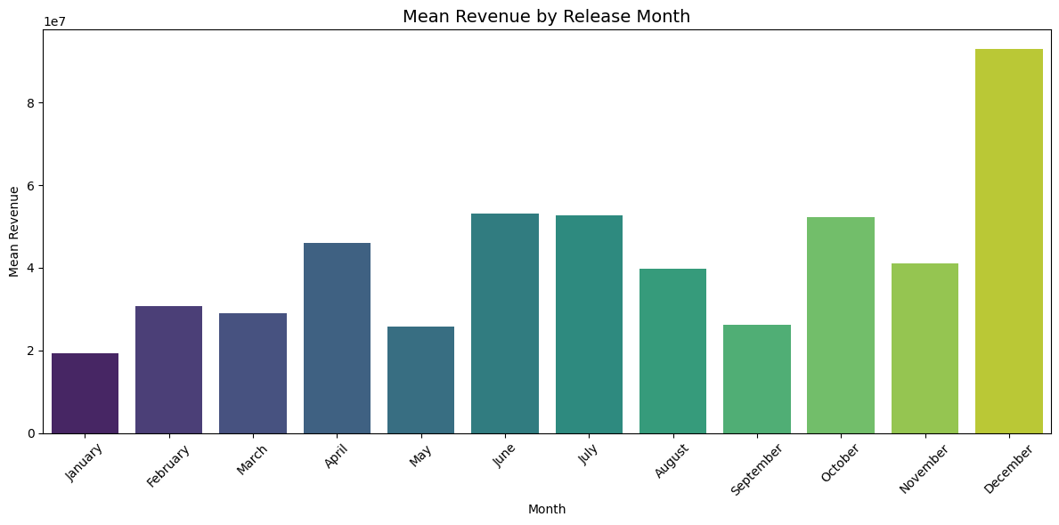
Release Month vs Revenue
Type: Line Plot or Bar Plot
Purpose: Measures seasonal effects on movie revenue.
Observation: Movies released in summer or holiday seasons tend to perform better.

Slide 12
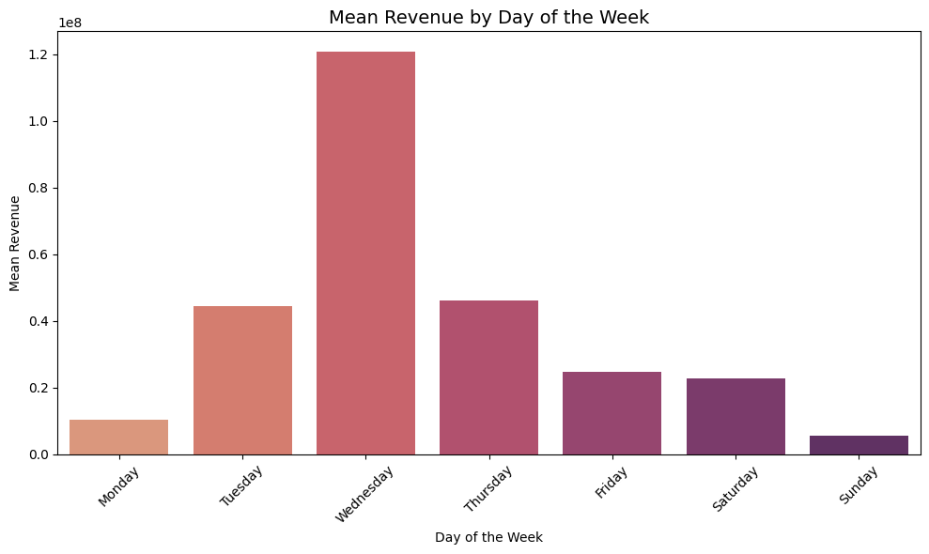
Revenue by Day of Week
Type: Bar Plot
Purpose: Reveals if revenue varies based on release weekday.
Observation: Weekends and Fridays usually see higher earnings.

Slide 13
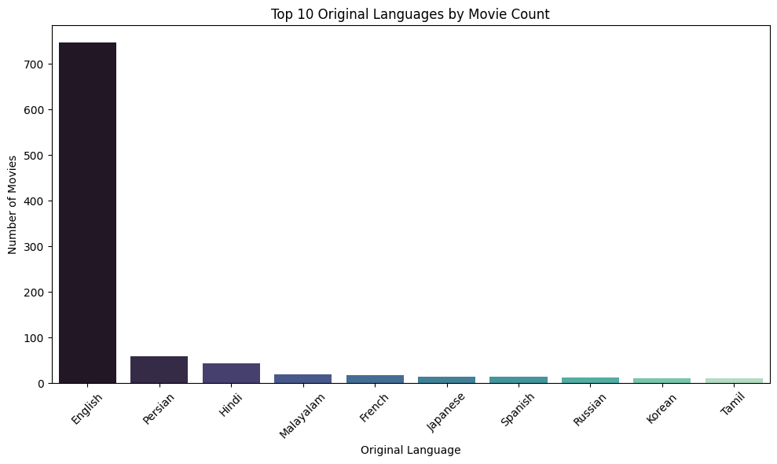
Language Distribution
Type: Pie Chart or Bar Chart
Purpose: Shows the number of movies per original language.
Observation: English dominates, but other languages are present depending on dataset.

Slide 14
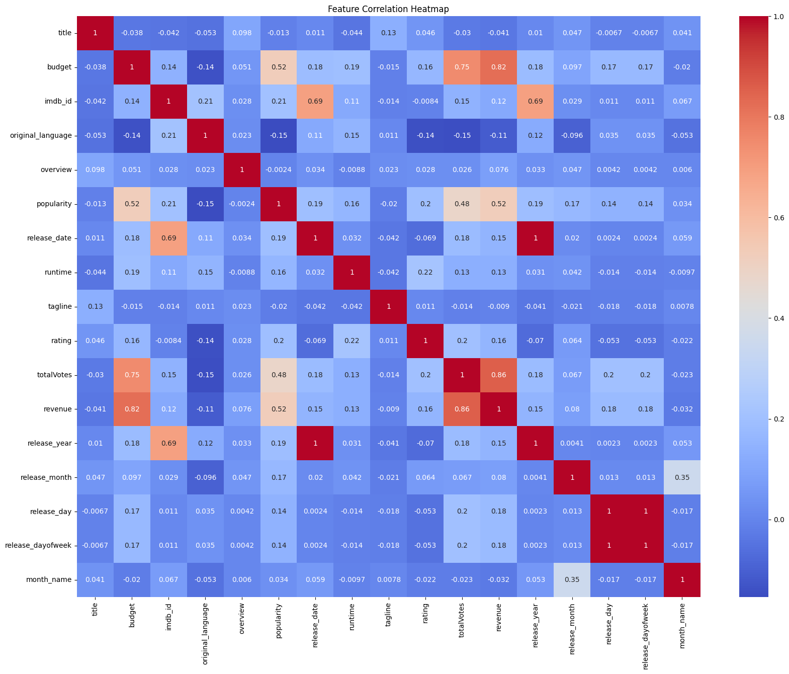
Correlation Heatmap
Type: Heatmap
Purpose: Shows the strength of relationships between numerical features.
Observation: Budget, popularity, and runtime often show strong correlation with revenue.

Slide 15
Machine Learning Model
A supervised learning model is trained on historical data.
Preprocessing includes:
* Scaling: Normalize numeric values using a scaler (e.g., Standard Scaler).
* Encoding: Convert categorical data into numeric form (if any).
Model is saved as 'movie_model.pkl'.
Scaler and encoders are also saved for consistent input formatting.

Slide 16
Results & Evaluation
Random Forest performed best:
- R² Score ≈ 0.88
- MAE ≈ 1.6M
Budget and Popularity were top predictors

Slide 17
Flask Web App Structure
Built using Flask framework in Python.
Routes:
* '/' → Renders input form (index.html).
* '/predict' → Accepts form input and returns prediction.
Prediction pipeline:
* Form input → Scaling → Model Prediction → Display Result.

Slide 18
Frontend Interface
index.html includes a form to take inputs from users:
* Budget
* Popularity
* Runtime
* Release Year

Slide 19
Demo / Workflow
1. User accesses homepage.
2. Fills input form.
3. Clicks 'Predict’.
4. Server processes data, predicts, and returns result.
5. Result is shown below the form.

Slide 20
Conclusion
Successfully deployed a machine learning model using Flask.
Predictive system for movie outcome based on numeric features.
Scalable architecture for adding more features or improving model.

Slide 21
THANK YOU ❤️

